Slide 1
Face Recognition
Jonathan D. Wallace

Slide 2
Purpose of Experiment
The experimenters wanted to compare the abilities between humans and A.I. program.
Significance:
The studied measured face identification accuracy for an international group of top professional forensic facial examiners and a deep-learning program.

Slide 3
How the experiment was conducted
Three groups:
Inexperienced individuals
Experienced professional forensic examiners
A.I. program
Each group were given a wide variety of information, images of people, for the participants to analyze. They were then instructed to compare the images and detect similarities among them.

Slide 4
Result:
Algorithms:
The performance increased monotonically from the older, to the newest, algorithms.
Human Performance:
The results varied, with the inexperience scoring the lower scores, while the professional scored the higher.
The best solution:
Is to have humans and A.I to hive and accurately function.

Slide 5
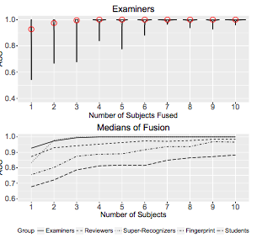
Results:
Accuracy peeked at 1.0
Which indicated that errors were not detected.
The best results came from combinations of a professional examiner and an A.I. facial recognition algorithm.

